Slide 1
ADJUS”TABLE”
BY KASHVI DAS- 25BST00021
DISHA RENGARAJAN-25BST0005

Slide 2
Problem statement
In most Indian homes, especially joint families, space is always a big problem. There are too many people and not enough room for separate furniture like study tables, dining tables, and coffee tables. This leads to clutter and less free space.
To solve this issue, we decided to design an adjustable multi-purpose table that can change its height and be used for different purposes like studying, eating, or relaxing. The project is simulated using Autodesk Fusion 360 to show how one simple design can save space and be useful in many ways.

Slide 3
What is Adjus”Table”
Adjus-Table is not just another piece of furniture — it’s a smart space-saving innovation designed for the realities of modern Indian homes. In a country where families share limited living space, Adjus-Table transforms with your needs.
With a simple height-adjustable design, it can instantly switch roles — from a coffee table for your living room, to a study desk for students, a dining surface for family meals, or even a bed table for comfort and convenience.
Our simulation in Autodesk Fusion 360 brings this idea to life, showing how a single, compact structure can deliver functionality, flexibility, and affordability — all in one design.
Adjus-Table is more than furniture — it’s a smart solution for small spaces, created with practical thinking and engineering precision.

Slide 4
Why is adjus”table” needed?
In today’s world, especially in India, space has become a luxury. With growing urbanization, most families live in compact apartments or shared joint-family homes where every square meter counts. Traditional furniture takes up too much room, offers limited functionality, and doesn’t adapt to changing needs.
Adjus-Table solves this problem by combining multiple uses in one design — it saves space, reduces cost, and adds flexibility to modern living. Whether it’s for students studying in small rooms, families living together, or working professionals needing a quick setup, Adjus-Table fits every purpose.

Slide 5
PROTOTYPE- USING AUTODESK FUSION 360

Slide 6
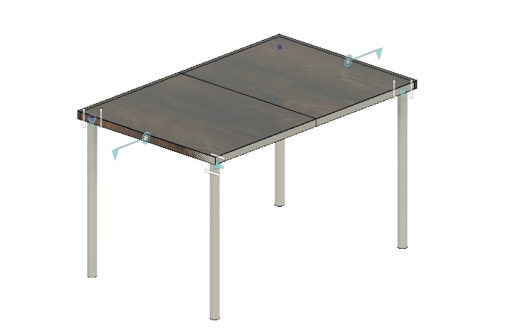
MODEL (without any adjustments)

Slide 7
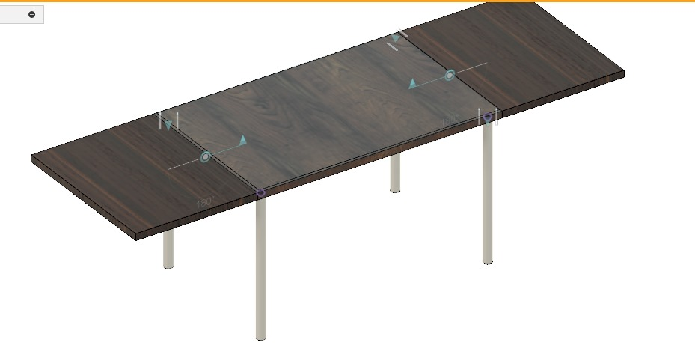
Length Extension

Slide 8
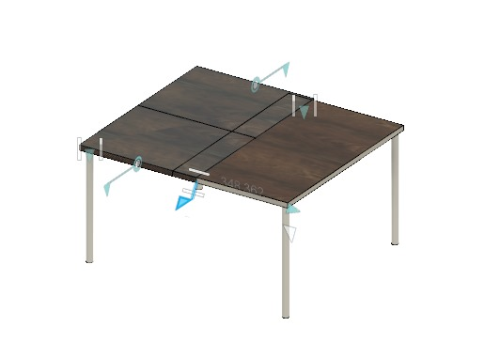
Breadth Extension

Slide 9
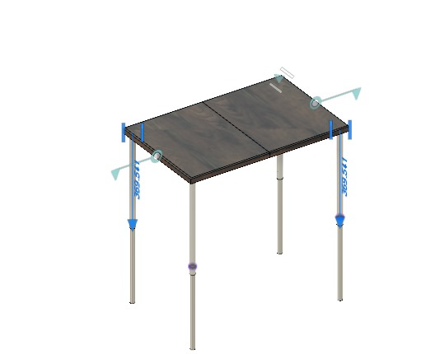
Height Extension

Slide 10
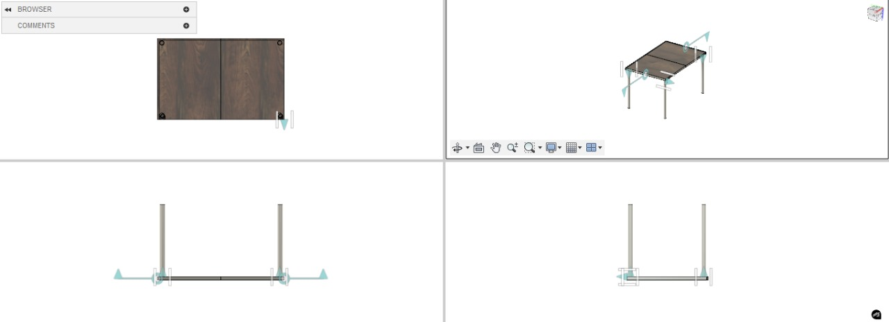

Slide 11
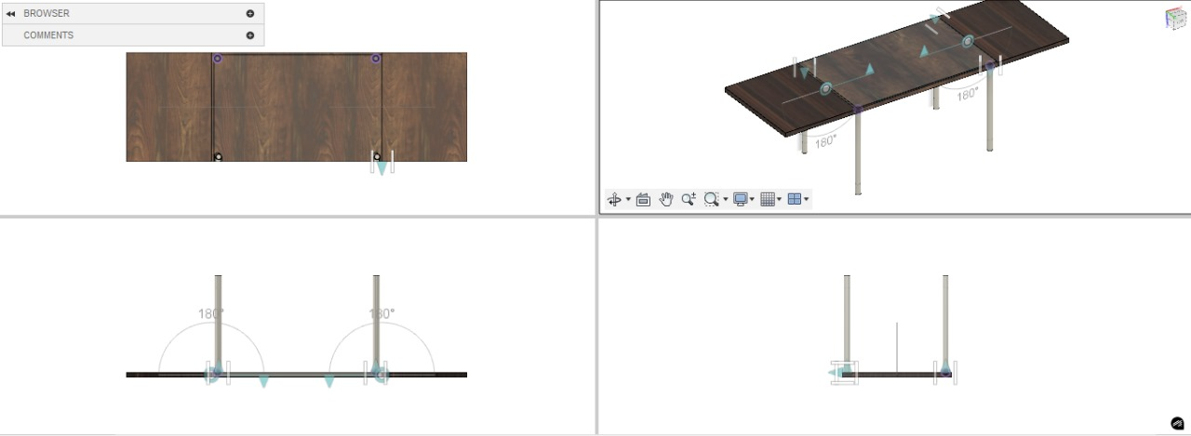

Slide 12
Commercial scope
The Adjus-Table has strong commercial potential in India, especially among lower middle-class families and students living in small homes or hostels. Its adjustable and multi-purpose design makes it affordable, space-saving, and extremely practical for daily use.
By using simple materials like mild steel and plywood, the production cost can be kept low, making it possible to sell the table at an affordable price of around ₹1,500 to ₹2,000. At this price, it offers great value for money and can easily attract a large customer base in both urban and semi-urban markets.

